Slide 1

Canadian Trade Analytics
BDAT 1010: Assignment 1
By - Fazle Siddique, Vivianne Wang, Vishal Kaatal, Mihir Indravadan Patel, Yugal Desai
Professor - Benjamin Van Arragon
Date - 03/11/2022

Slide 2

Introduction & Data Specs
International trade makes up for most of the world economy, so studying trades between Canada and the world grants insight into Canadian economy.
Source: https://www150.statcan.gc.ca/t1/tbl1/en/tv.action?pid=1210013001&pickMembers%5B0%5D=2.1&cubeTimeFrame.startYear=2000&cubeTimeFrame.endYear=2021&referencePeriods=20000101%2C20210101
Cleaning: Checked for rows with null values, found 3 columns which are entirely empty so removed them. No other null values were found. Already structured for our analysis.

Slide 3

Dimensionality Reduction
Techniques Used
3 most significant columns
Missing Value Ratio
Low Variance
High Correlation
Random Forrest
Backward Feature Extraction
REF_DATE', 'Trading Partner’, 'North American Product Classification System (NAPCS)', 'Trade'
Forward Feature Selection
Trading Partner
'Trading Partner’, 'North American Product Classification System (NAPCS)', 'Trade'

Slide 4
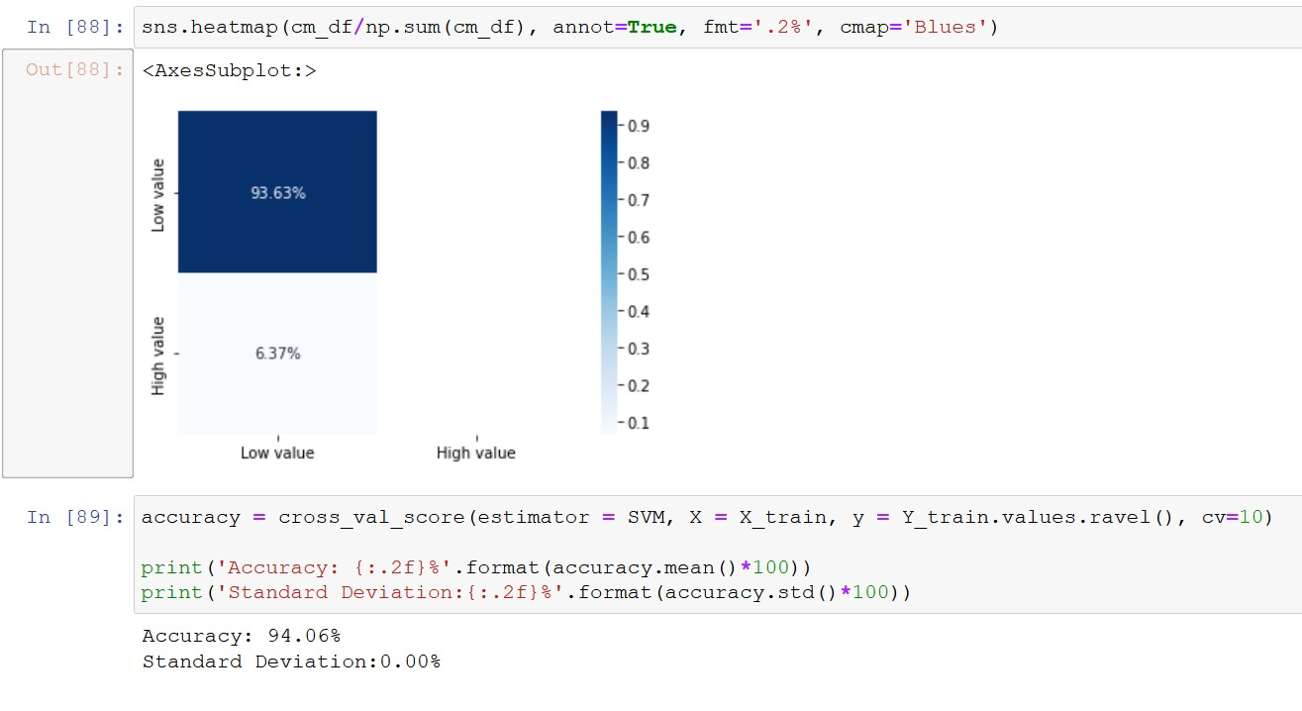
Classification Technique
Target Variable: Value_ID
Support Vector Machine (SVM)
Decision Tree: classes that dominate majorly generate a biased tree
K-Means: not a dedicated classification tool, so no a good idea to use
Vivianne

Slide 5
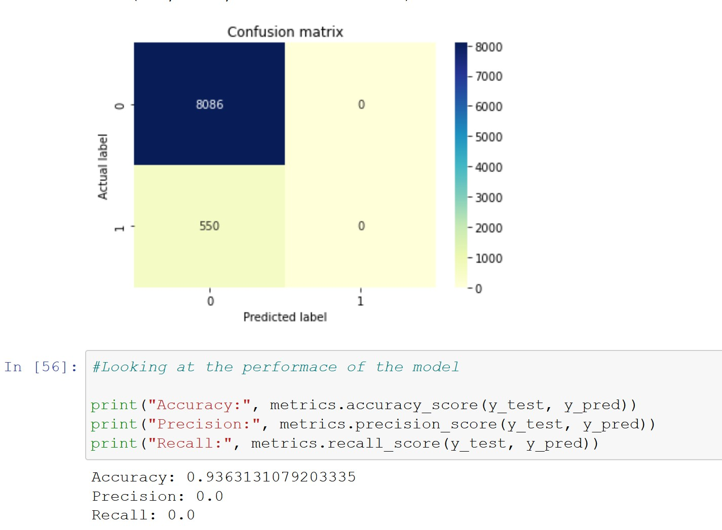
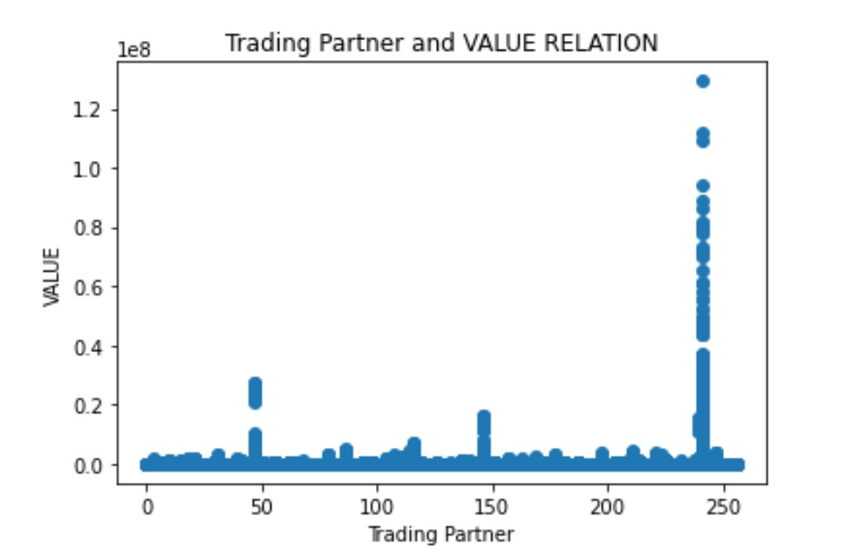
Regression Technique
Target Variable: Value_ID
Logistic Regression
Linear Regression works best with variables with variables with linear relationships. However, it doesn’t fit in our class, on the other hand, logistic is better.
Vivianne

Slide 6
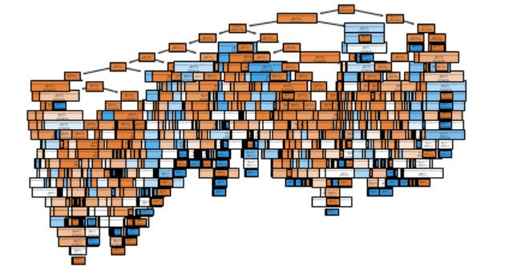
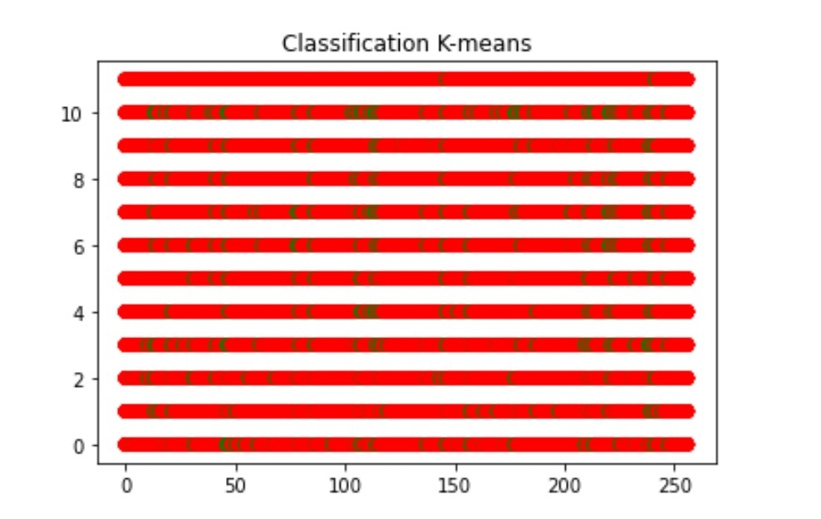
Max Performance Models
Decision Tree: Due to bias caused by larger countries in Trading Partner column leads overly complex trees thus, overfitting.
Logistic Regression: Because linear regression is not good. Trading Partner and Value little to no linear relationship.
Decision Tree & Logistic Regression
Decision Tree: 100.0 %
SVM: 94.06 %
K-Means:
Linear Regression: ~0.0045051057704259545, 0.4%
Logistic Regression: 0.9363131079203335, ~93%
Vivianne

Slide 7
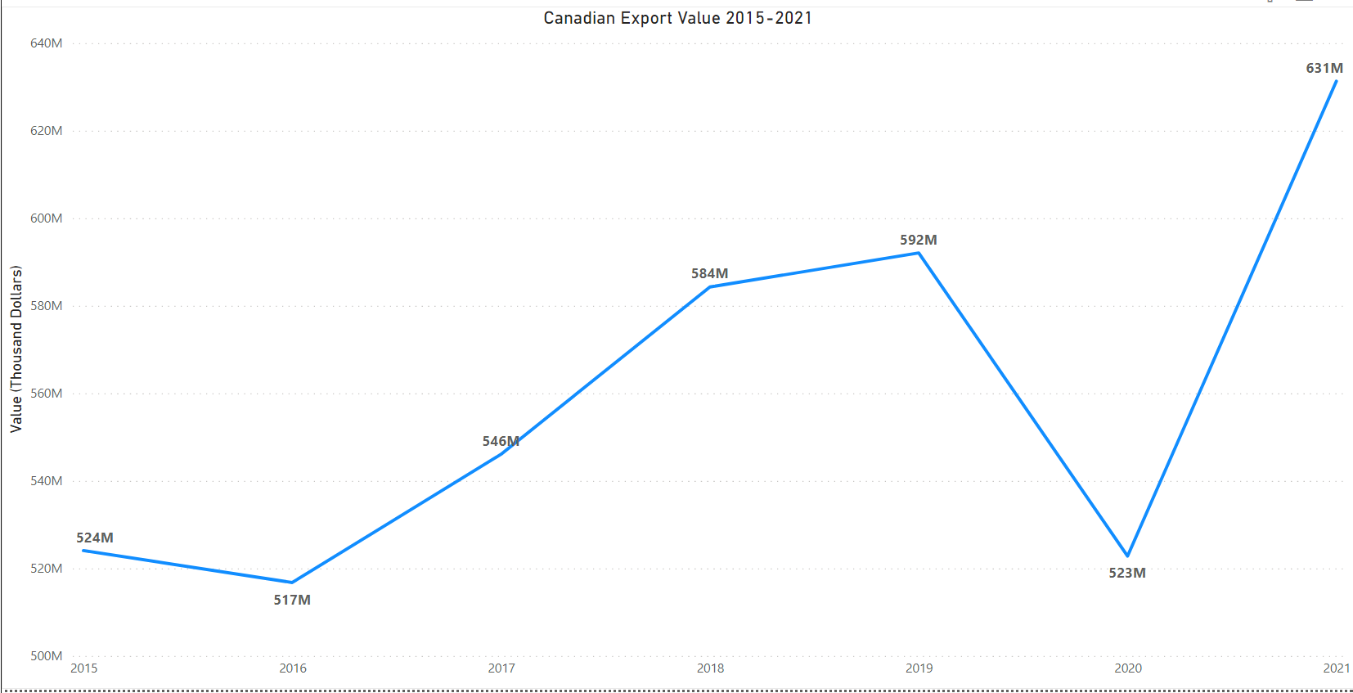
What Year did Canada earn the most from exports?
2016 to 2019 increasing earnings
Covid March 2020 started likely cause of drop
Slowly starting to recover in trade activities
Year 2021 highest earnings from exports, roughly 631million in value times 1000 to convert to dollars, 631 billion dollars
Yugal

Slide 8
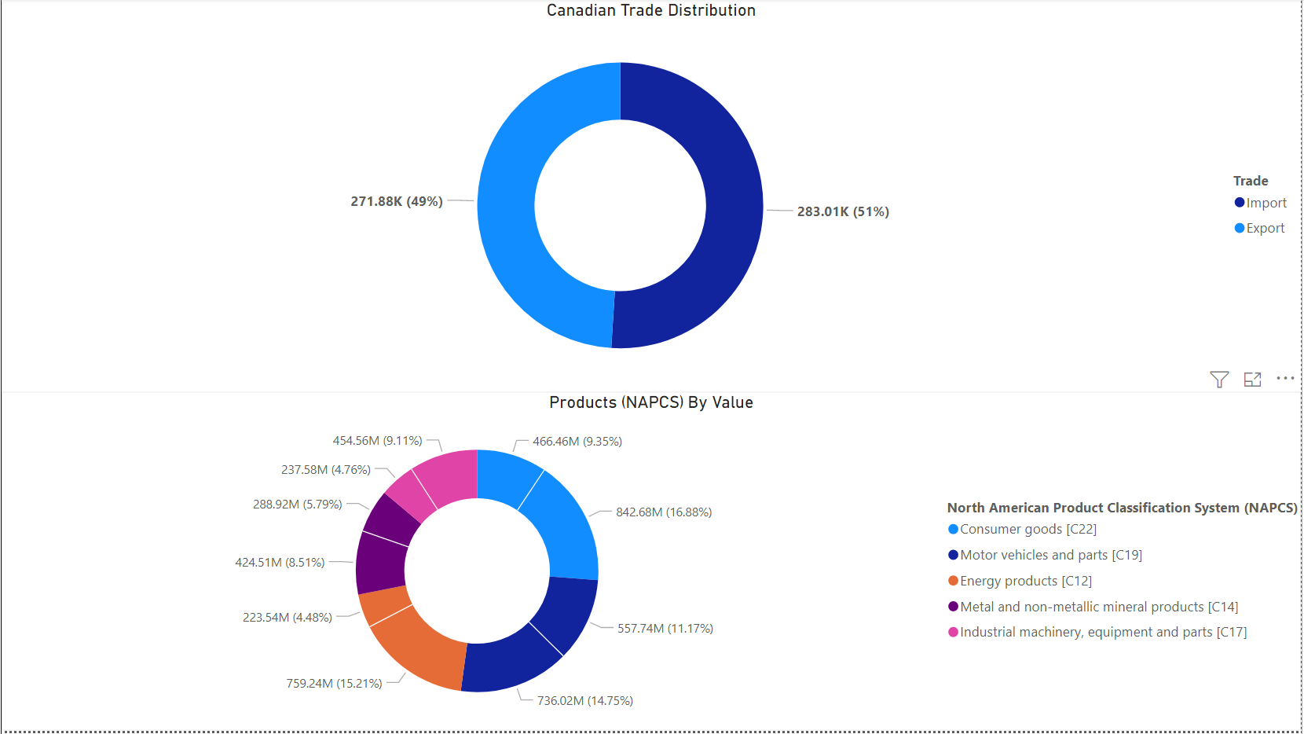
On average what has the most value in Canadian export or import?
Importing Consumer Goods
Spends most on imports on average, little over 50%
Consumer goods accounts for little over 25% of all trades
Canada spends the most on importing consumer goods, roughly 16.88%

Slide 9
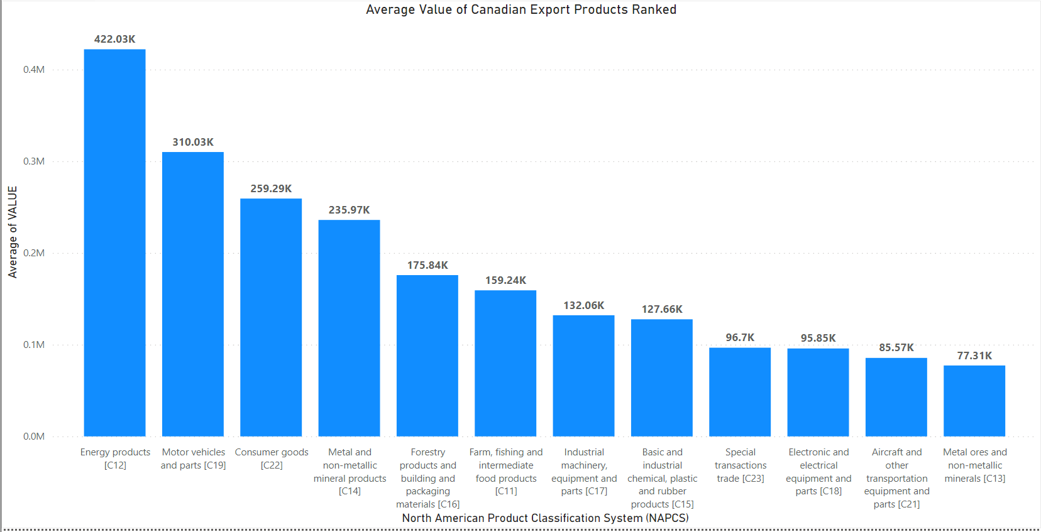
On average which type of products does Canada earn the most from exports?
Energy Products
Roughly 422k (in thousand dollars), ~422million dollars
Doesn’t earn much from metal ores or non-metal minerals
Large difference between Motor vehicles and parts which is second place
Roughly 310k (in thousand dollars), ~310 million dollars

Slide 10
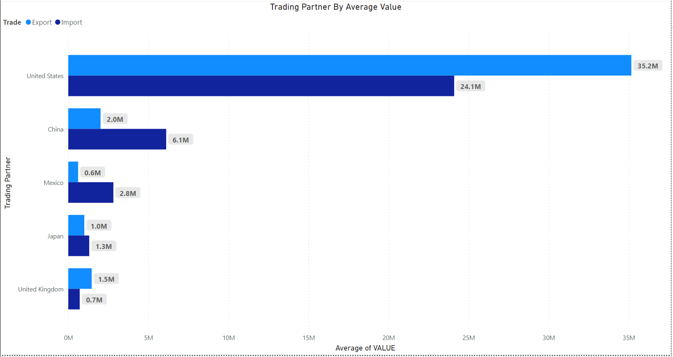
What are the top countries with the highest overall average trade values with Canada?
USA & CHINA
USA,
exports ~35million in thousands of dollars, 35billion dollars
Imports ~24million in thousands of dollars, 24billion dollars
Both vastly greater than China which is in second place
China,
exports ~2million in thousands of dollars, 2billion dollars
Imports ~6million in thousands of dollars, 6billion dollars
Still quite a bit greater than 3rd place Mexico
Mihir

Slide 11
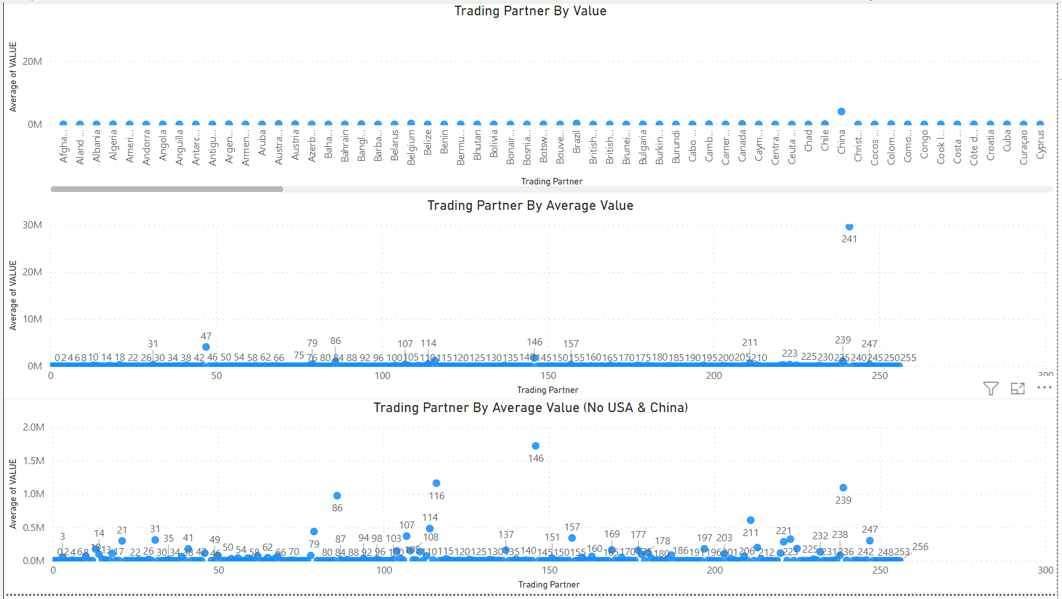
Is there a relationship between the country Canada trades with and can it be used to predict value of a trade?
Not Linear, no cant be used
There doesn’t appear to be a linear relationship between trading partner and value of trade, at least not a linear or random relationship.
It can't be used to predict trade value.
Even if you consider USA and China trade values as outliers and remove them from consideration there does not appear to be a linear relationship.
It is unlikely that there is a relation ship between the variable of trading partner and average value of trades.

Slide 12
Conclusion
Invest more in energy product production and marketing with USA = greater Canadian income
Thank You

